Slide 1
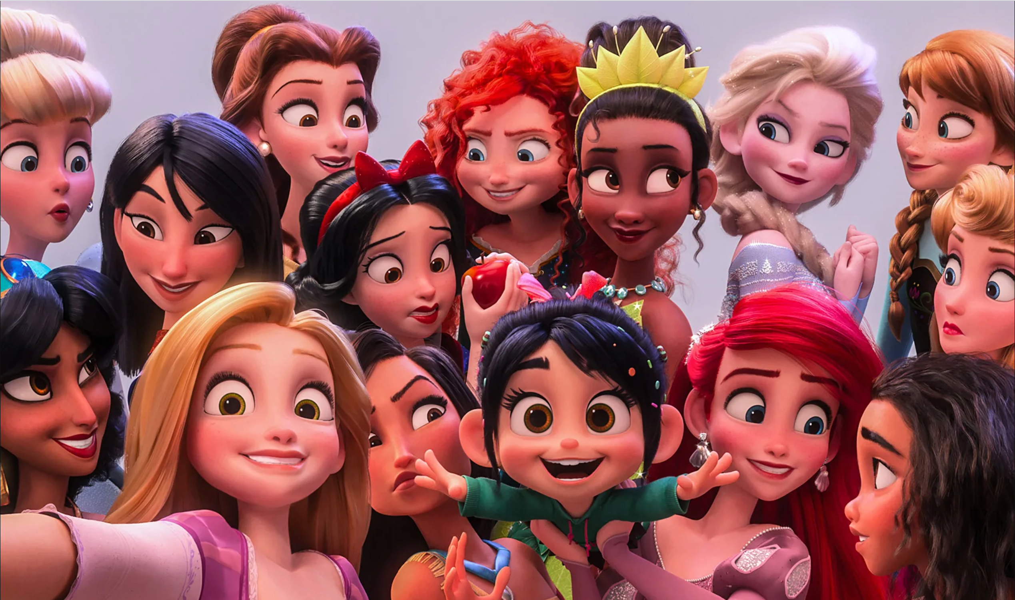
Miss Jeremy’s perfect and peculiar princesses…

Slide 2
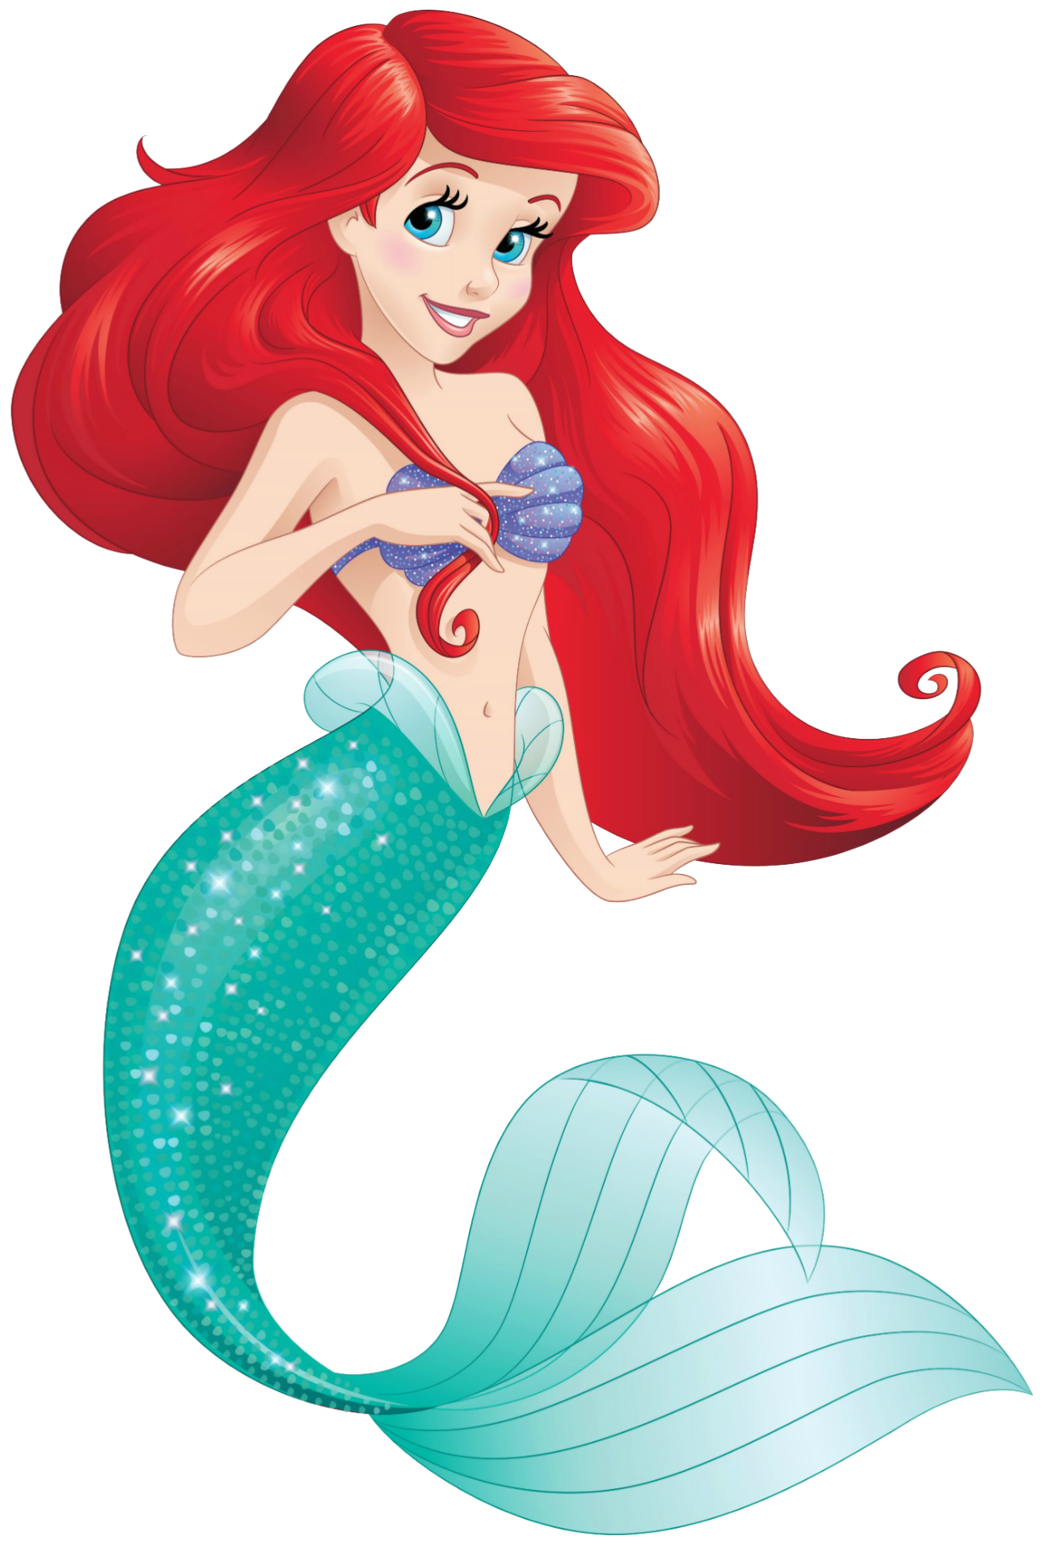
Do you know who this princess is?

Slide 3
Do you know who this princess is?
ARIEL!
Ariel is a mermaid princess and the youngest of King Triton and Queen Athena's seven daughters.^{[5]} She is often seen in the company of Flounder her best friend, and Sebastian, her father's advisor who is often assigned to keep an eye on her.
Ariel has a fascination with the human world and often goes off to find human artefacts that she displays in a secret grotto.
Ariel is often rebellious, wandering off on her own to explore her surroundings, and frequently disobeys the orders of her father or Sebastian, causing conflict between the characters.
Watch this clip on Ariel

Slide 4
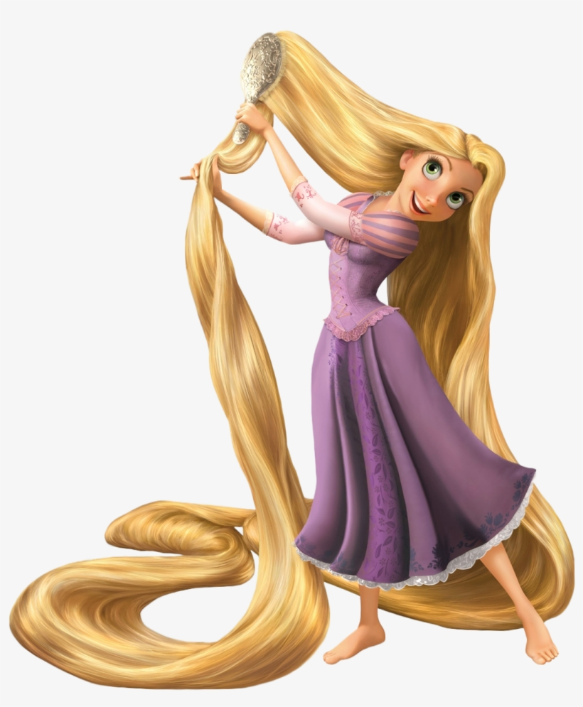
Do you know who this princess is?

Slide 5
Do you know who this princess is?
RAPUNZEL!
Rapunzel is a spirited, smart, clever, kind, playful, and a very adventurous girl in her late teens, though a bit naive. However, she is not afraid to stand up for herself or others when the situation calls for bravery. She has long, golden hair with incredible magical qualities…
Watch this clip on Rapunzel

Slide 6
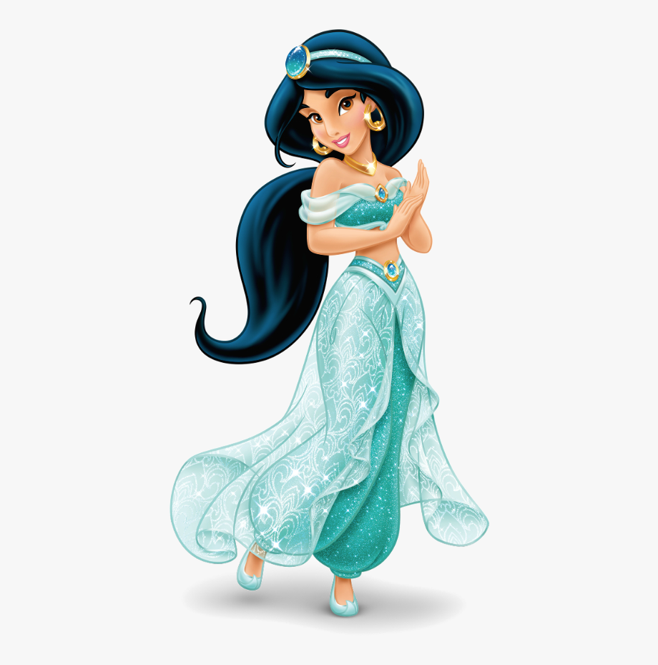
Do you know who this princess is?

Slide 7
Do you know who this Disney princess is?
JASMINE!
Jasmine is the spirited Princess of Agrabah, who has grown weary of her life of palace confinement.
Despite an age-old law stating that the princess must marry a prince in time for her upcoming birthday, Jasmine is instead determined to marry someone she loves for who he is as opposed to what he owns.
Watch this clip on Jasmine

Slide 8
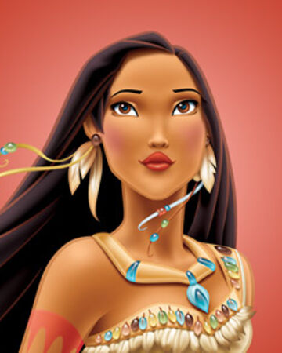
Do you know who this princess is?

Slide 9
Do you know who this princess is?
POCAHONTAS!
Pocahontas is the daughter of Chief Powhatan, the leader of a Native American tribe in Virgina. She is a noble, free-spirited, and highly spiritual young woman. She expresses wisdom beyond her years and offers kindness and guidance to those around her. She loves her homeland, adventure, and nature.
Watch this clip on Pocahontas

Slide 10
Do you know who this princess is?

Slide 11
Do you know who this princess is?
MOANA!
Moana, as Gramma Tala describes, "stands out from the crowd". She is sea-loving, headstrong, strong-willed, practically fearless, and physically capable. Though she has moments of self-doubt, she has great pride in who she is, and is generally too stubborn to back away from new challenges.
Watch this clip on Moana

Slide 12
QUIZ!
Which princess has a deep love of her homeland, adventure, and nature?
A
B
C

Slide 13
QUIZ!
Which princess is described as sea-loving, headstrong and practically fearless?
A
B
C

Slide 14
QUIZ!
Which princess is the daughter of King Triton and Queen Athena?
A
B
C

Slide 15
QUIZ!
Which princess is determined to marry someone she truly loves instead of someone who is just rich?
A
B
C

Slide 16
QUIZ!
Which princess is not afraid to stand up for herself or others when the situation calls for bravery?
A
B
C

